Slide 1


Backend (Node.js) Automated Testing
Notes:
In backend we almost always write test for our endpoints
I takes much more time to test manually than aotumaticly
This is the biggest motivation
For each route, we will check several inputs, like the working and erros pattern
Before writing the actual test, write the wrapper, describe what u want to test

Slide 2
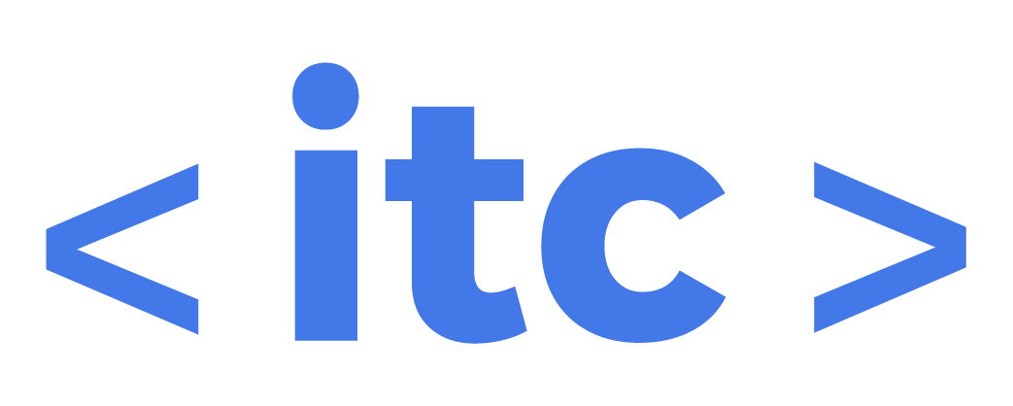
Agenda
Writing basic endpoint tests
Initializing data (beforeAll) and fakers
Clearing data (afterAll)
Testing valid and invalid responses
E2E (end to end) testing
Test/code coverage - definition of “done”
https://github.com/israeltechchallenge/express-mysql-boilerplate

Slide 3
Manual tests
Manual testing your server can be done using postman, curl, or any other web client.
Manual testing after every change, can be daunting
Testing manually is time consuming and doesn’t scale! Also, it is not bulletproof against future changes (by you or other programmers)

Slide 4
First step - writing a test description
Describe the unit you want to test
For each case, create a test case
const app = require('../app');
const request = require('supertest');
describe('Get products', () => {
//...
it('Get inactive products', async () => {

Slide 5
Second step - initializing data
In case we want to test a unit that retrieves data, we need to initialize it in our db
We will use the faker module from npm
Then we just need to insert the data to our db
We will do it in the beforeAll hook
const { query } = require('../lib/mysql');
const faker = require('faker');
describe('Get products', () => {
const products = new Array(3).fill(1).map((_, i) => ({
id: faker.random.uuid(),
name: faker.commerce.productName(),
price: Math.round(faker.random.number()),
is_active: i % 2 === 0
}));
beforeAll(async () => {
const productValues = products
.map(p => `('${p.id}', '${p.name}', ${p.price}, ${p.is_active})`)
.join(', ');
const sql = `INSERT INTO products (id, name, price, is_active) VALUES ${productValues}`;
await query(sql);
});

Slide 6
Third step - filling the tests
Now we can test the endpoint (unit)
We don’t want to open the express server in a given port (in case there are multiple servers running in the same time for parallel test)
We will use supertest module to fake http requests
const app = require('../app');
const request = require('supertest');
//...
it('Get inactive products', async () => {
const res = await request(app).get('/products');
expect(res.statusCode).toBe(200);
const inactiveProducts = products.filter(p => !p.is_active);
expect(res.body.products.length).toBe(inactiveProducts.length);
inactiveProducts.forEach(ip => {
expect(res.body.products.find(p => p.id === ip.id)).toBeDefined();
});
});

Slide 7
Fourth step - cleaning
We clean the db after each suite, so it won’t fail other tests in our project
We will use the afterAll hook to delete the data in our db
afterAll(async () => {
const ids = products.map(p => `'${p.id}'`).join(',');
await query(`DELETE FROM products WHERE id IN (${ids})`);
});

Slide 8
Why cleaning?
You will have multiple tests testing different parts of your app
Each test will be based on the assumption that the db is in a given state

Slide 9
Testing invalid request
You can (and should) test that your endpoints send the right response on an invalid request
it('Bad new product input', async () => {
const res = await request(app).post('/products').send({ name: '1' });
expect(res.statusCode).toBe(400);
});

Slide 10
E2E (end to end) testing
Until now we did unit testing - we want to start testing small parts of our software
E2E testing is when we want to test how multiple units work together
For example - create a new product, then get all products and make sure it is there

Slide 11
Test/code coverage
In production/real world applications, writing tests is a must
When working on a feature (which includes functions, endpoints, components etc.) you must cover your code with basic unit testing
This is called code/test coverage - how much of your code is has tests
The goal is always to stay as close as possible to 100%

Slide 12
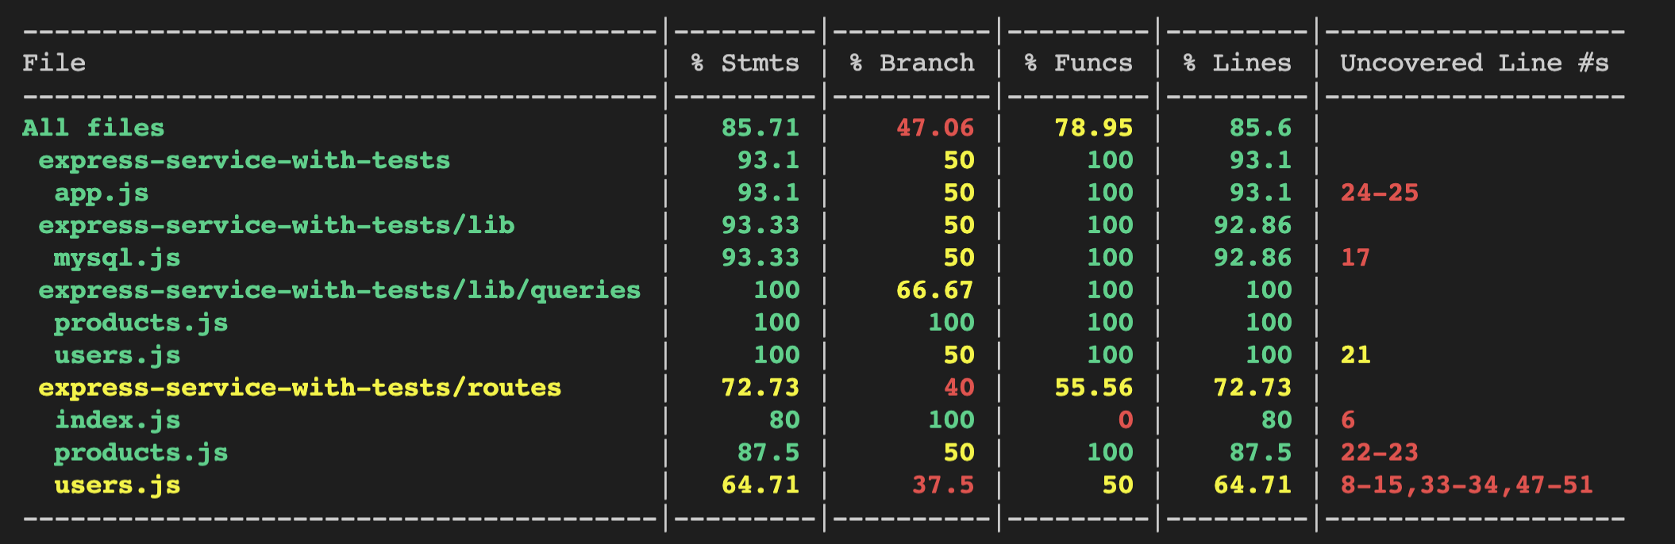
Test coverage with jest
By using the --coverage flag when running Jest, we let it analyze our code and check what is covered with tests and what not

Slide 13
Definition of “Done”
Until now you wrote functionalities and tested them manually
From now, your work is not considered “done” only after you covered your code with tests
When working in teams that ship code to production (to be used by clients/users) not writing tests means you didn’t finish your work
Especially in backend code - as it manages the application data and state

